Slide 1
Final Year Project
Metaphor detection and interpretation
Presented by: 田展
Notes:
a6c1c6e5-a568-4b8f-9619-923f6e3d3eea

Slide 2
1
Background & Introduction

Slide 3
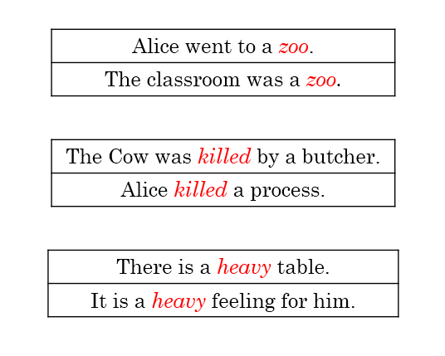
What is metaphor?
Metaphor does not use “as” or “like” for figurative description. It describe things with vivid explanations for some abstract experience and perception.

Slide 4
Classification on metaphor
Structural classification
Nominal metaphor: Life is a journey -> Life is wonderful.
Verbal metaphor: The society waked up -> The society realized something.
Adjectival metaphor: A bleak song -> A weak sound
Red means the source domain and the blue means the target domain.
Other classification appears little, not discuss here.

Slide 5


We usually use metaphor expression in daily life, but how possible a computer detect and understand metaphors?
Students
By linguistic theories !!!
Recent researchers

Slide 6
How to detect metaphors by modern linguistics ways?
Conceptual metaphor theory
Metaphor Identification Procedure
systematic reasoning
from a concrete conceptual source domain mapping to an abstract target domain
Metaphor appears when literal meaning of a word contrasts with the context meaning
Interaction
Selectional Preference Violation
Interaction of two meanings raises metaphor based on a single phrase. (source)
The result semantic is the result of interaction.
metaphoricity is identified by detecting the incongruity between a target word and its context.

Slide 7
Various linguistic theories provides plenty of possible ways for the improvements of performance.
Recent researchers

Slide 8
2
Task description

Slide 9
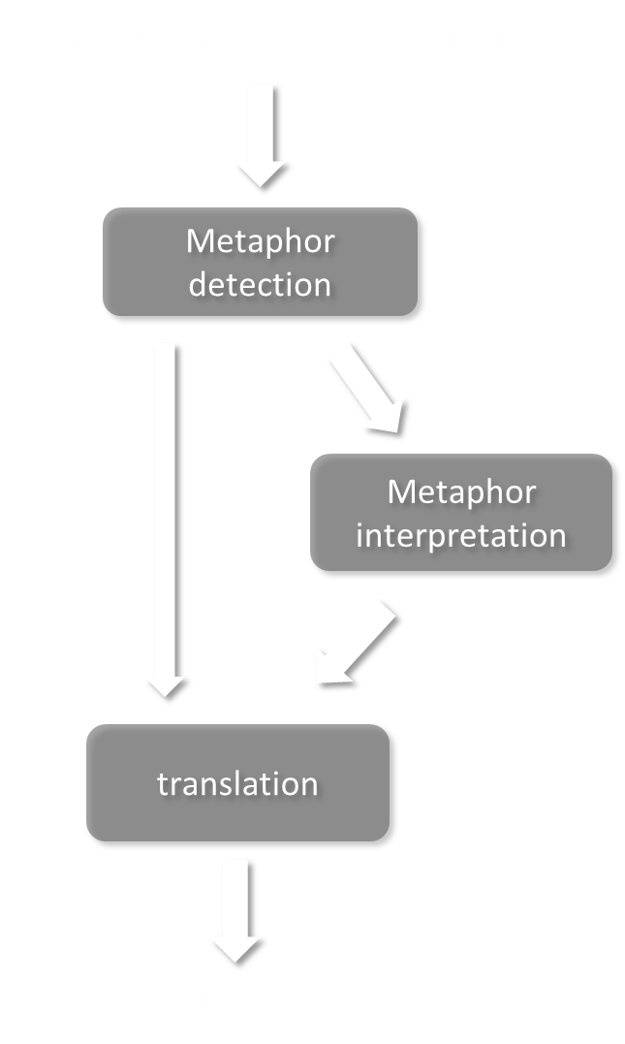
Our task aims to direct raise the correctness of machine translation.
Identify if this sentence contain any metaphorical expression.
Interpret into the most suitable literal words.

Slide 10
3
Metaphor detection models

Slide 11
Related work
Word Embedding and WordNet Based Metaphor Identification and Interpretation
Neural network based metaphor detection
Neural Metaphor Detecting with CNN-LSTM Model
Sequential Metaphor Identification Inspired by Linguistic Theories

Slide 12
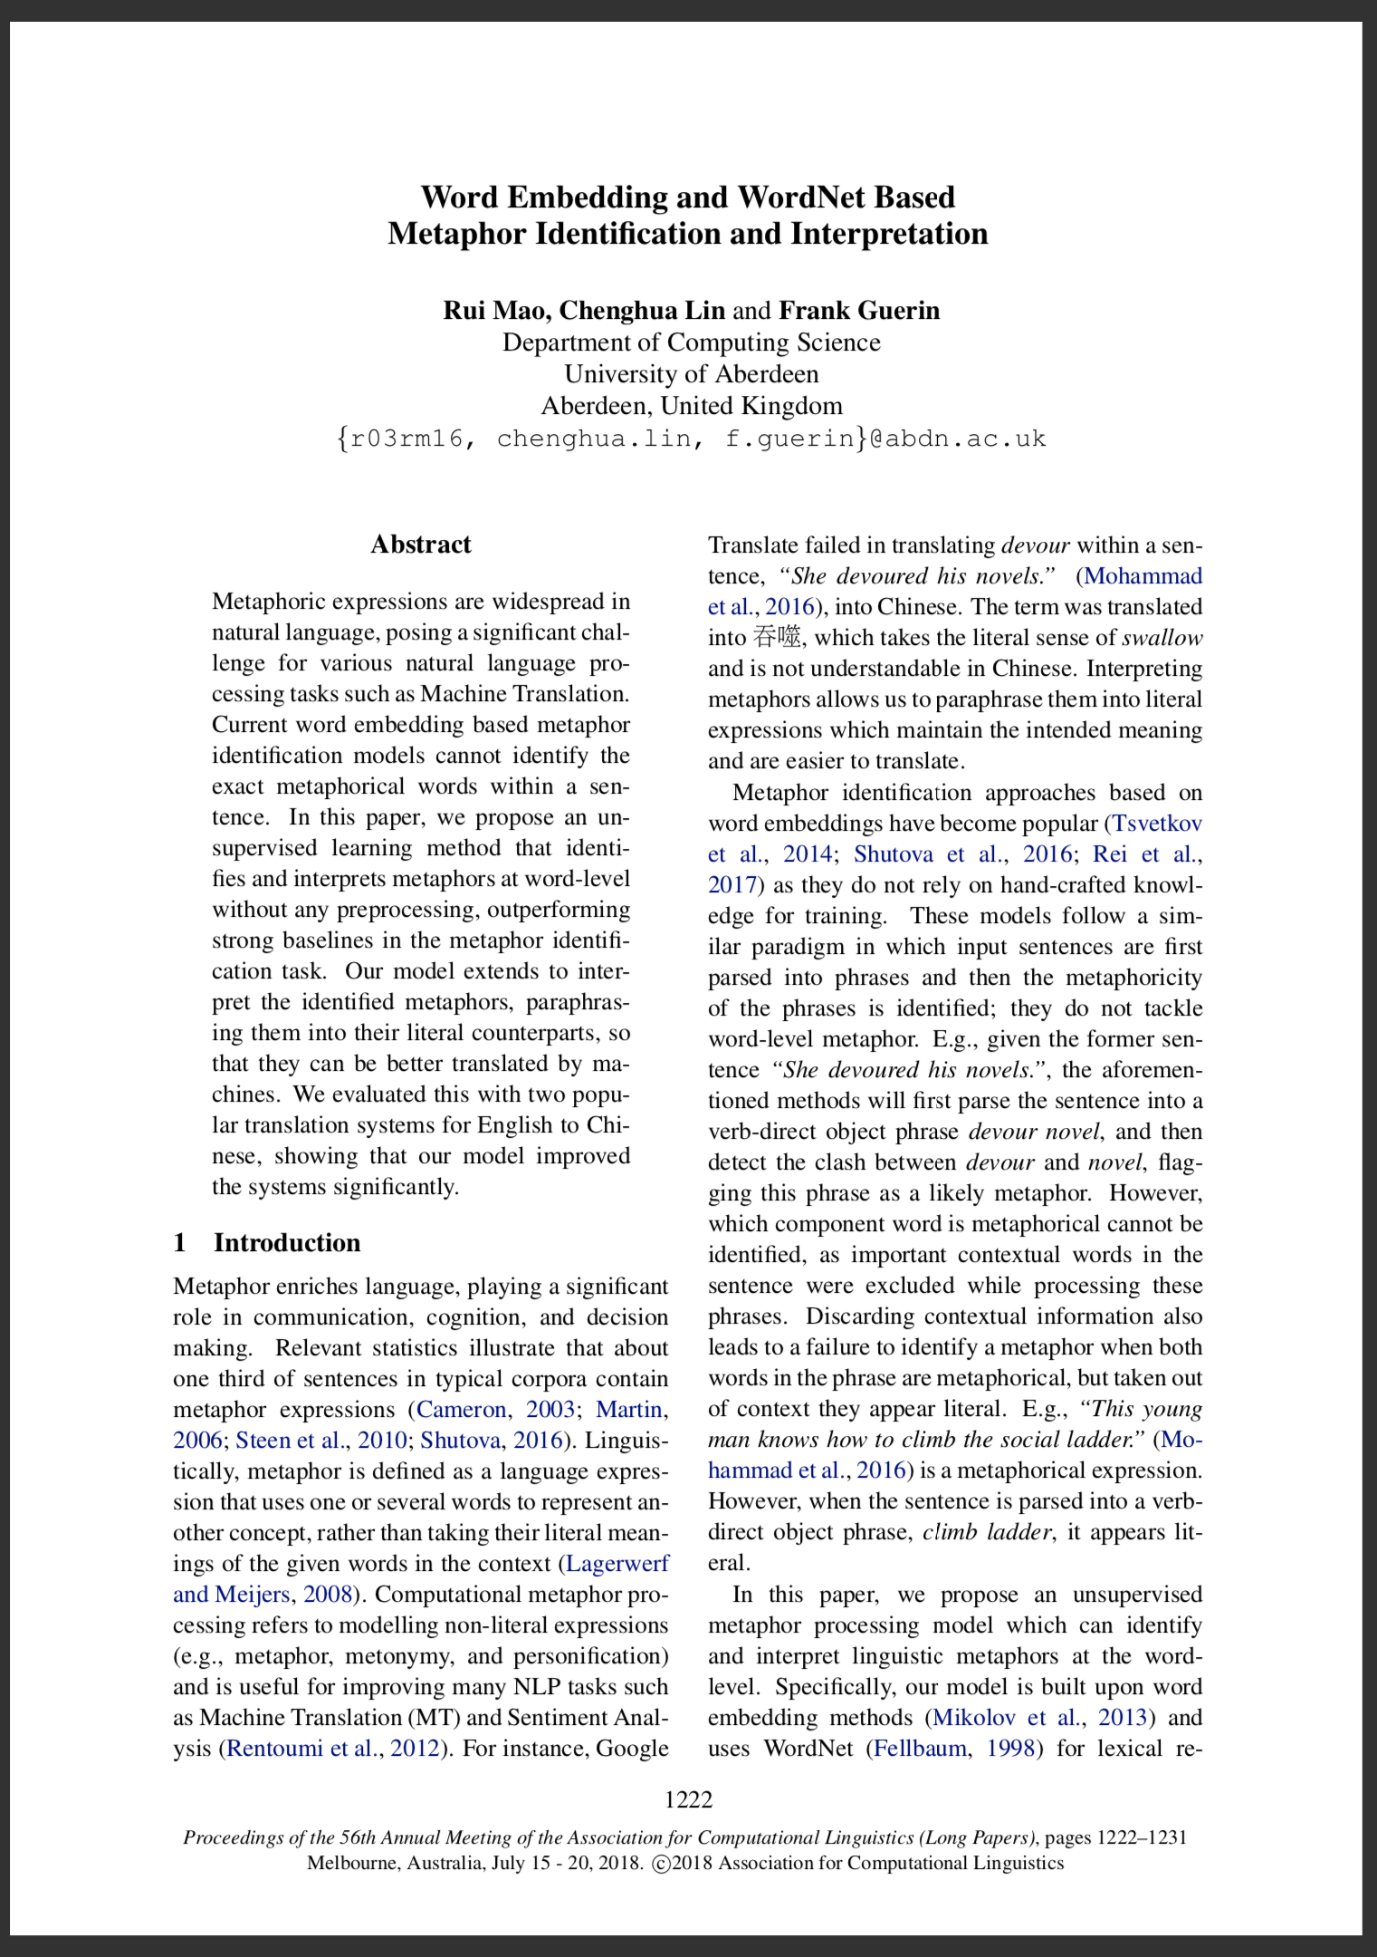
paper
Word Embedding and WordNet Based Metaphor Identification and Interpretation
[Rui Mao, Chenghua Lin and Frank Guerin]
Word Embedding
word vectors & spatial relationship
WordNet
synonyms and hypernyms

Slide 13
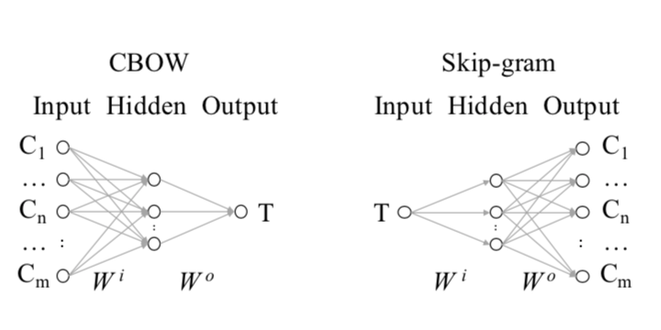
paper
Word Embedding and WordNet Based Metaphor Identification and Interpretation
based on Continuous Bag of Words (CBOW) and Skip-gram
( Skip-gram, a reverse of CBOW )
CBOW is trained by maximizing the probability of predicting a center word, given its context

Slide 14
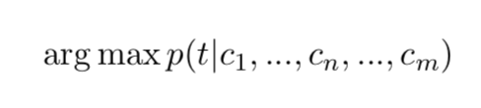
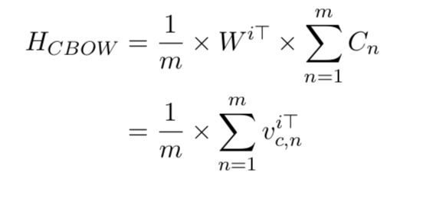
paper
Word Embedding and WordNet Based Metaphor Identification and Interpretation
Model is trained by maximizing the probability of predicting a centre word, given its context.
CBOW’s hidden layer is defined as:

Slide 15
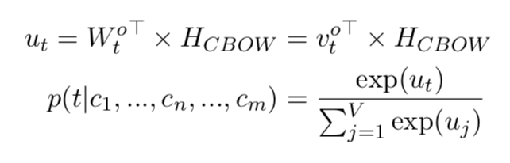
paper
Word Embedding and WordNet Based Metaphor Identification and Interpretation
The probability of predicting a center word in its context is given by a softmax function below:

Slide 16
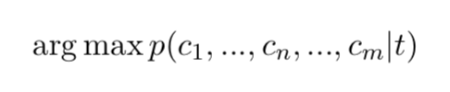
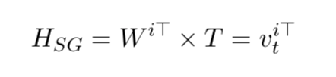
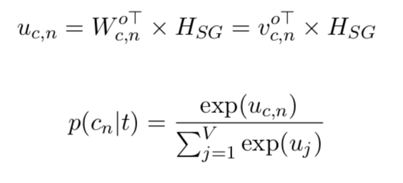
paper
Word Embedding and WordNet Based Metaphor Identification and Interpretation
Skip-gram is the reverse of CBOW
Maximize the probability of predicting each context word, given a center word:
Hidden layer is defined as:
Probability of a context word:

Slide 17
paper
Word Embedding and WordNet Based Metaphor Identification and Interpretation
The names of center word and context word embeddings are reversed in CBOW and Skip-gram
Word embeddings represent both input and output vectors.

Slide 18
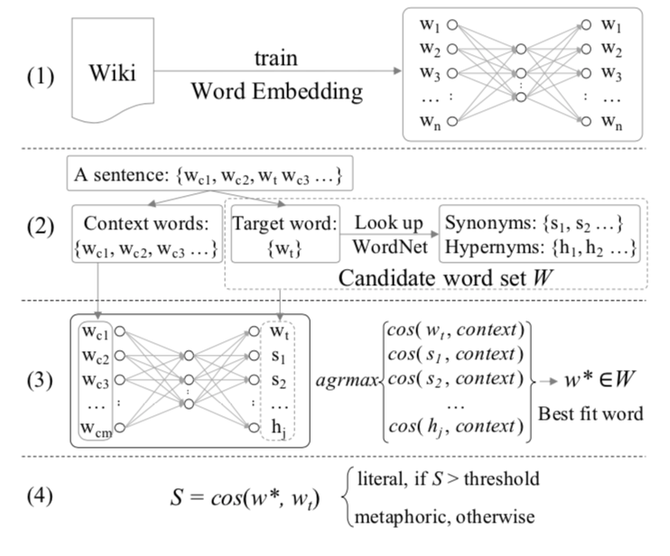
paper
Word Embedding and WordNet Based Metaphor Identification and Interpretation
Word Embedding
Wikipedia dumps
Separate center word & context words
synonyms and hypernyms
augment the set (candidate)
identify the best fit word
maximum weight of vectors
determine the attribute
by cosine similarity
literal or metaphoric

Slide 19
Neural network based metaphor detection
developed methods
The initial neural network implementation
Neural Metaphor Detection in Context
Neural Metaphor Detecting with CNN-LSTM Model
Sequential Metaphor Identification Inspired by Linguistic Theories

Slide 20
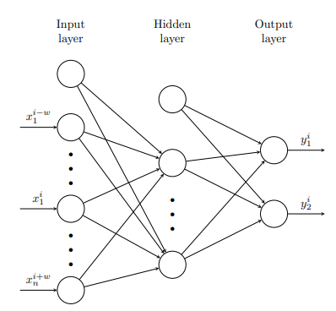
Neural network based metaphor detection
The initial neural network implementation
Treat as a tagging problem
Train without any manual labeling
Experiment with multilayer perceptrons
with connected feedforward neural network.

Slide 21
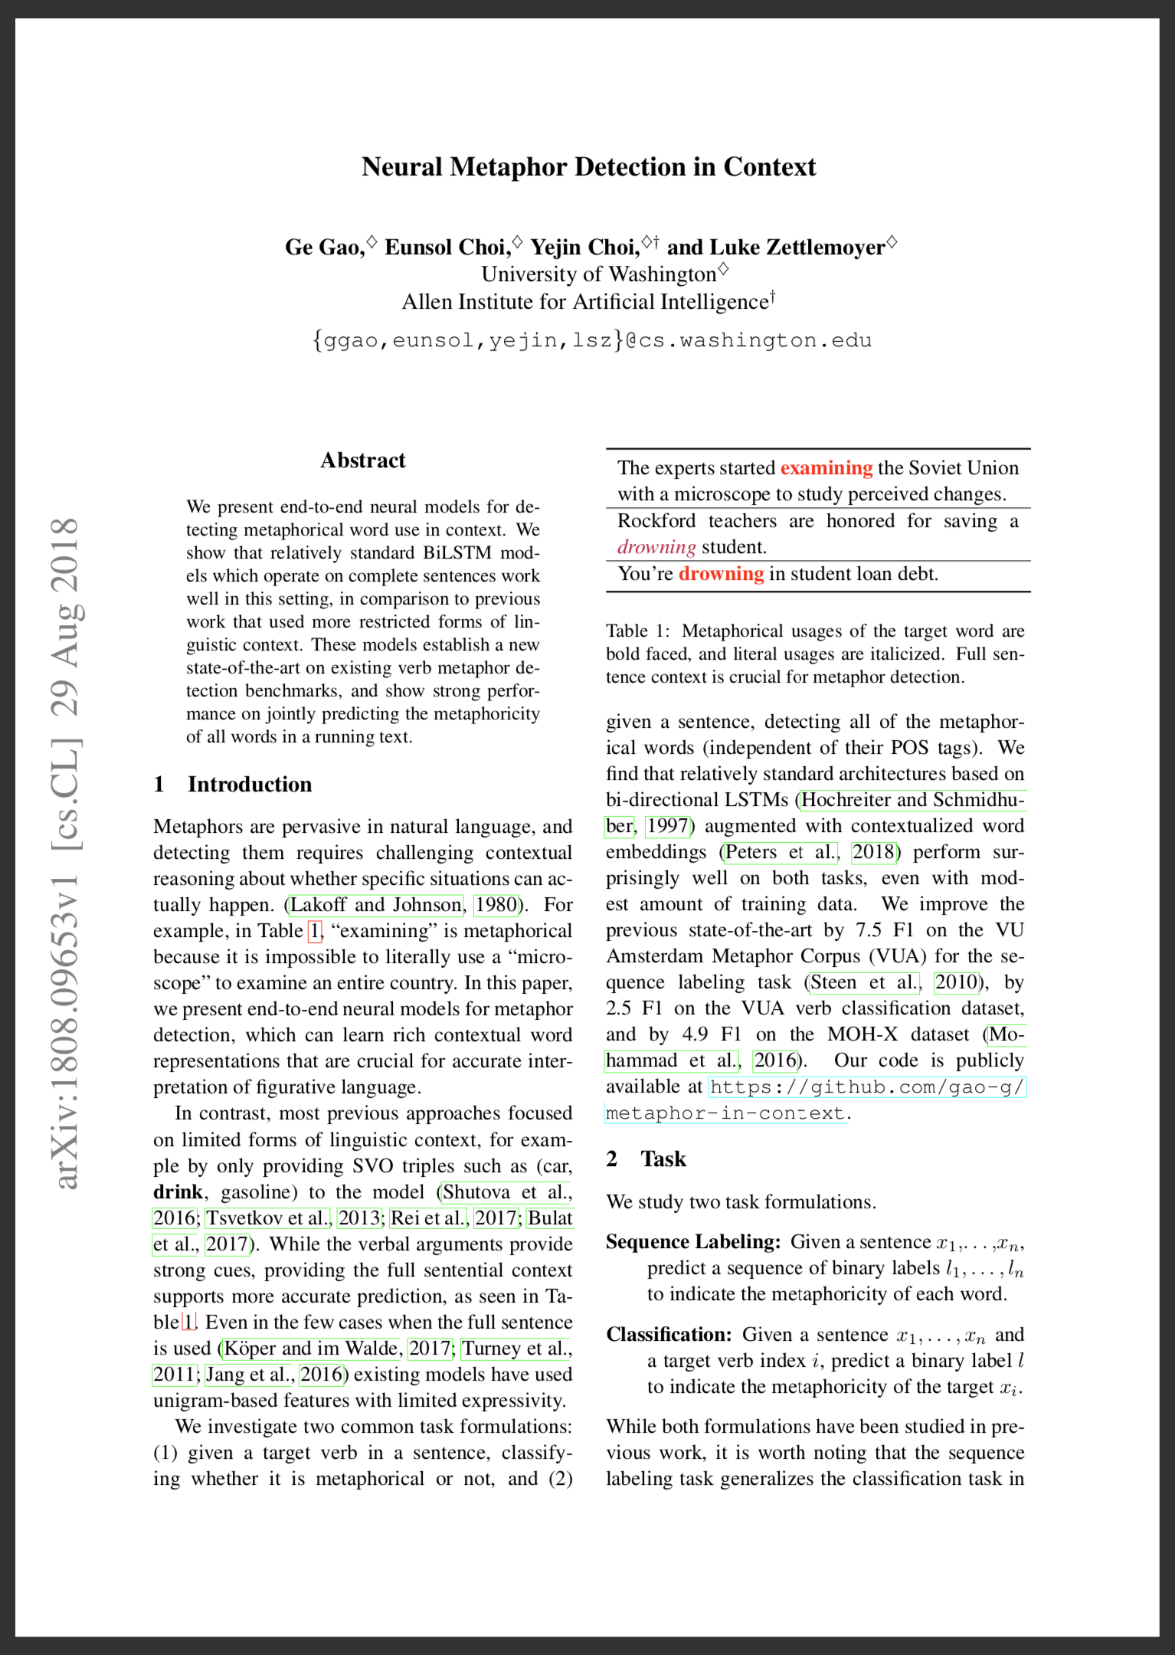
paper
Neural Metaphor Detection in Context
[Ge Gao, Eunsol Choi, Yejin Choi, and Luke Zettlemoyer]
Construct the interaction relation between target word and context
interaction -> semantic model

Slide 22
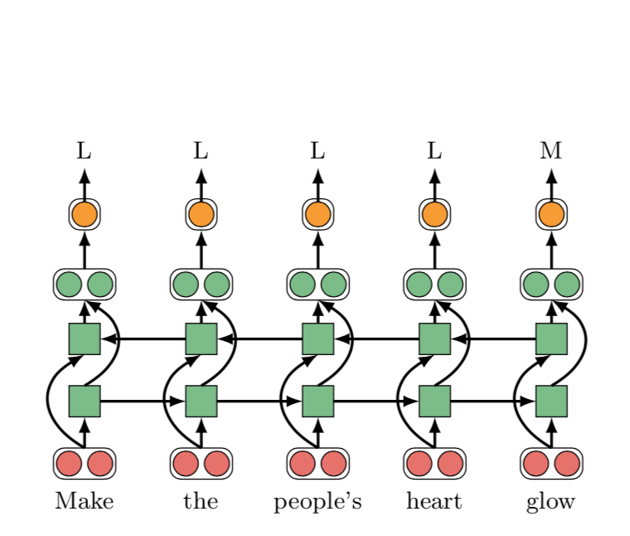
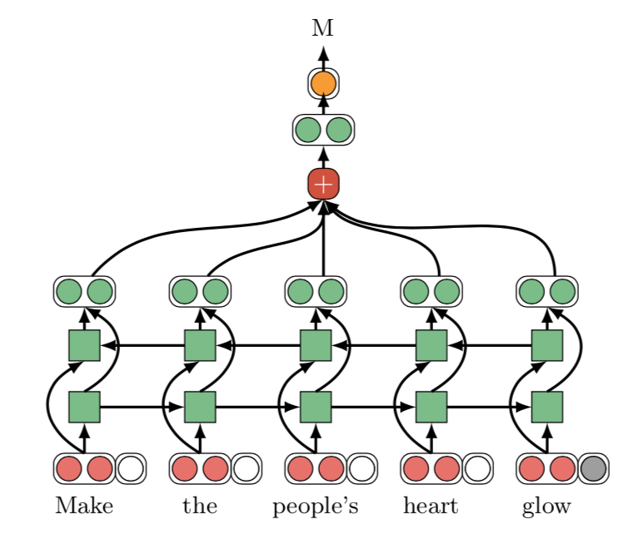
paper
Neural Metaphor Detection in Context
Neural Metaphor Detection in Context
Based on bi-directional LSTMs (BiLSTM) augments with contextualized word embedding
Add an index embedding to indicate the target word
Add an attention layer

Slide 23
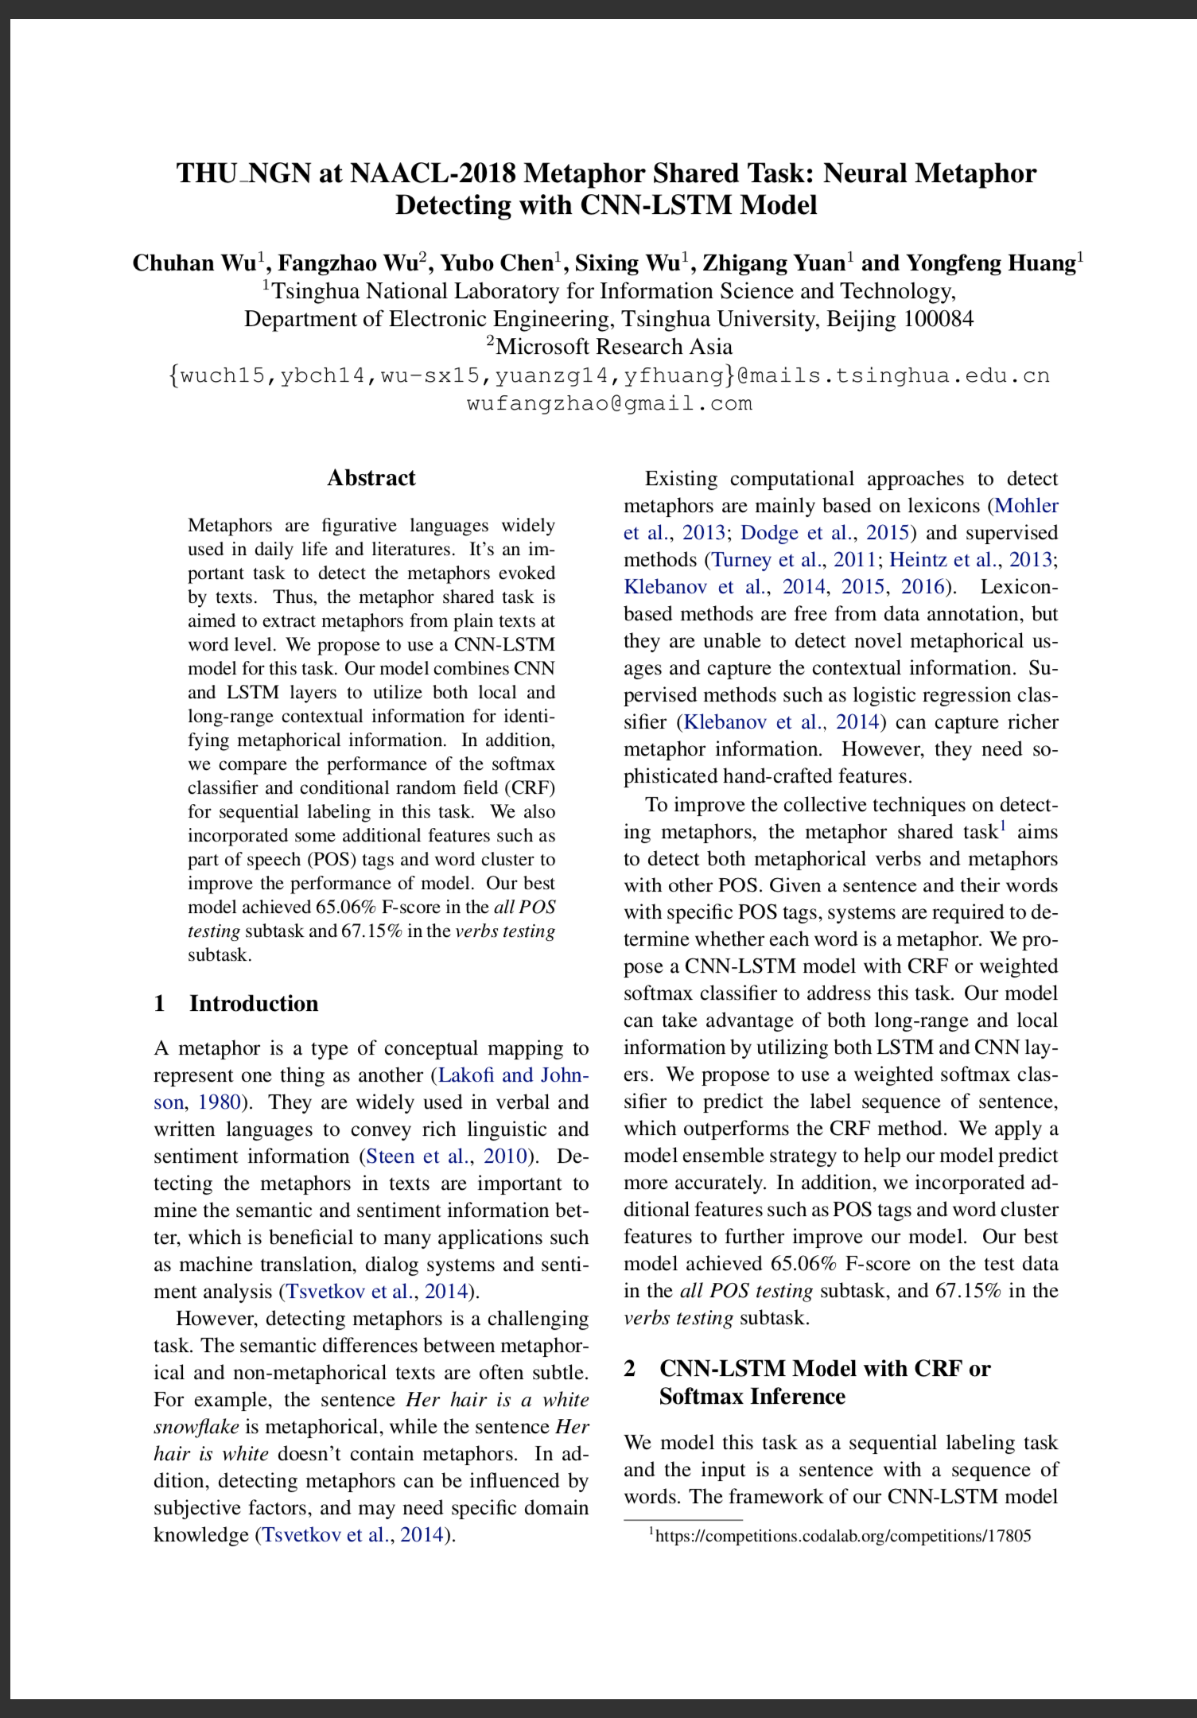
paper
Neural Metaphor Detecting with CNN-LSTM Model
Utilize the pre-trained word vector for input
Use the combination of CNN and BiLSTM for processing
CNN - capture the local context information
BiLSTM - capture the global context information
Full-connected CRF or softmax layer for prediction

Slide 24
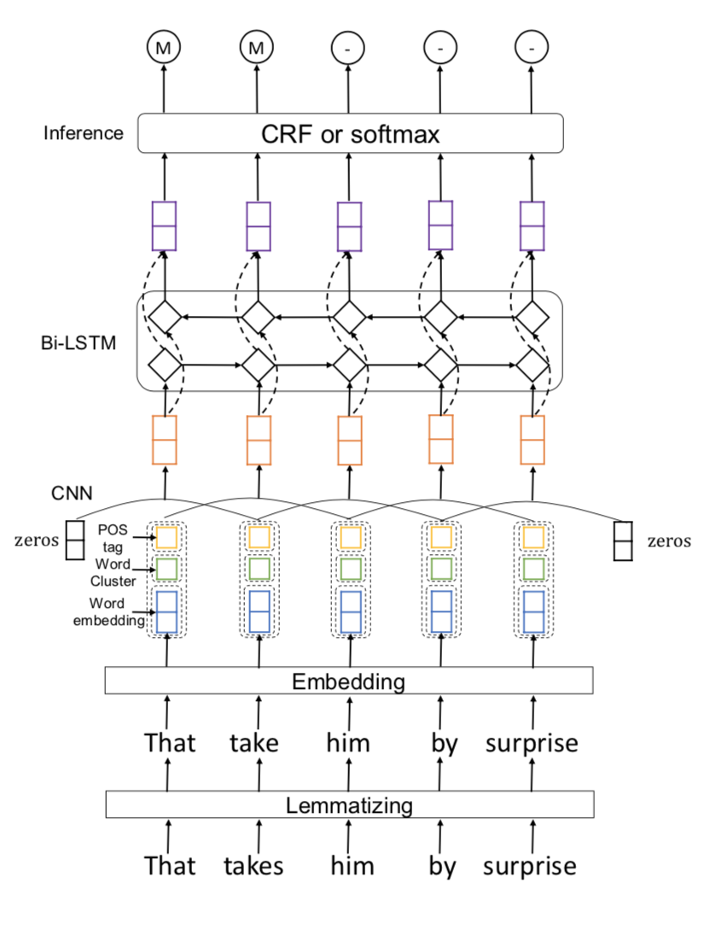
paper
Neural Metaphor Detecting with CNN-LSTM Model
lemmatization layer
lemmatized word
simplify the semantic information
reduce the word number

Slide 25
paper
Neural Metaphor Detecting with CNN-LSTM Model
lemmatized word
simplify the semantic information
reduce the word number

Slide 26
4
Metaphor interpretation models

Slide 27
Intuition
Our task:
Find a literal meaning
to replace it
She devoured his novels
She ? his novels

Slide 28
Main problem
Context
Culture
CBOW(Continuous Bag-Of-Words Model)
linguistic theory
Target Word ⭐
Semantic
Neg/pos

Slide 29
Using metaphor word
Time is treasure
Time is money
How do human understand metaphors
Knowledge!!!

Slide 30
How to use target word
Method 1:
Find same property
Method 2:
Find similar word

Slide 31
Method 1
The aircraft’s engine is regarded as the heart
Find the same property from both words

Slide 32
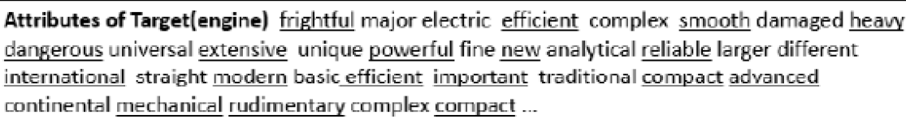
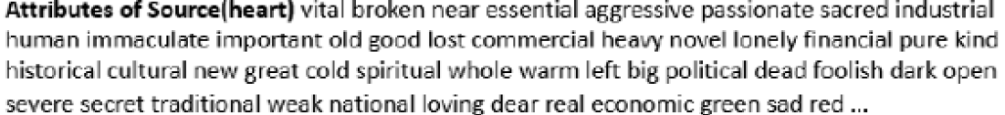
How to use knowledge

Slide 33
Classification on metaphor
property | similarity
important | 0.0214371
efficient | 0.0146519
disruptive | 0.0146124
conventional | 0.0145793
engine is important

Slide 34
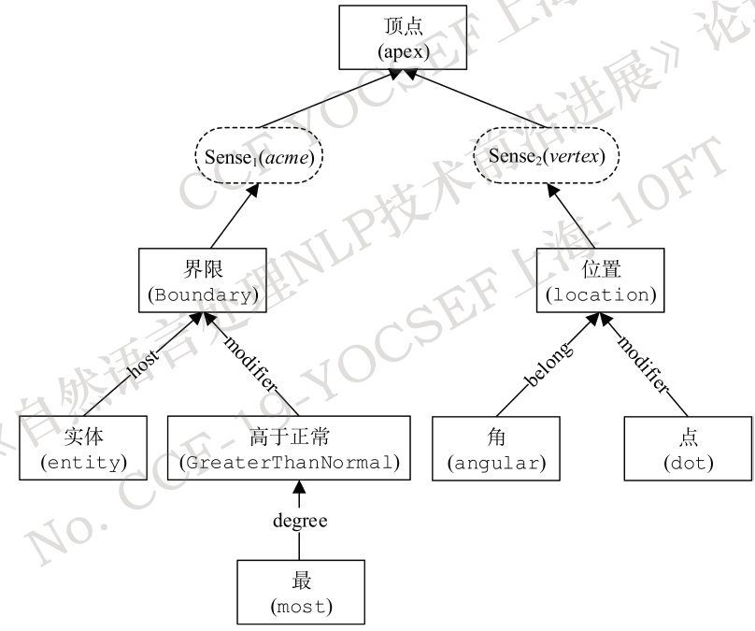
Method 2 : Knowledge base
WordNet:
VerbNet
a large lexical database
Interlinked by means of conceptual-semantic and lexical relations
largest on-line network of English verbs
HowNet
‘Ling’ word vector
Based on sememe (义原)
a large lexical database of Chinese
Non-distributional Word Vector Representations

Slide 35

Method 2 : Example
The experts started examining the Soviet Union with a microscope to study perceived changes

Slide 36
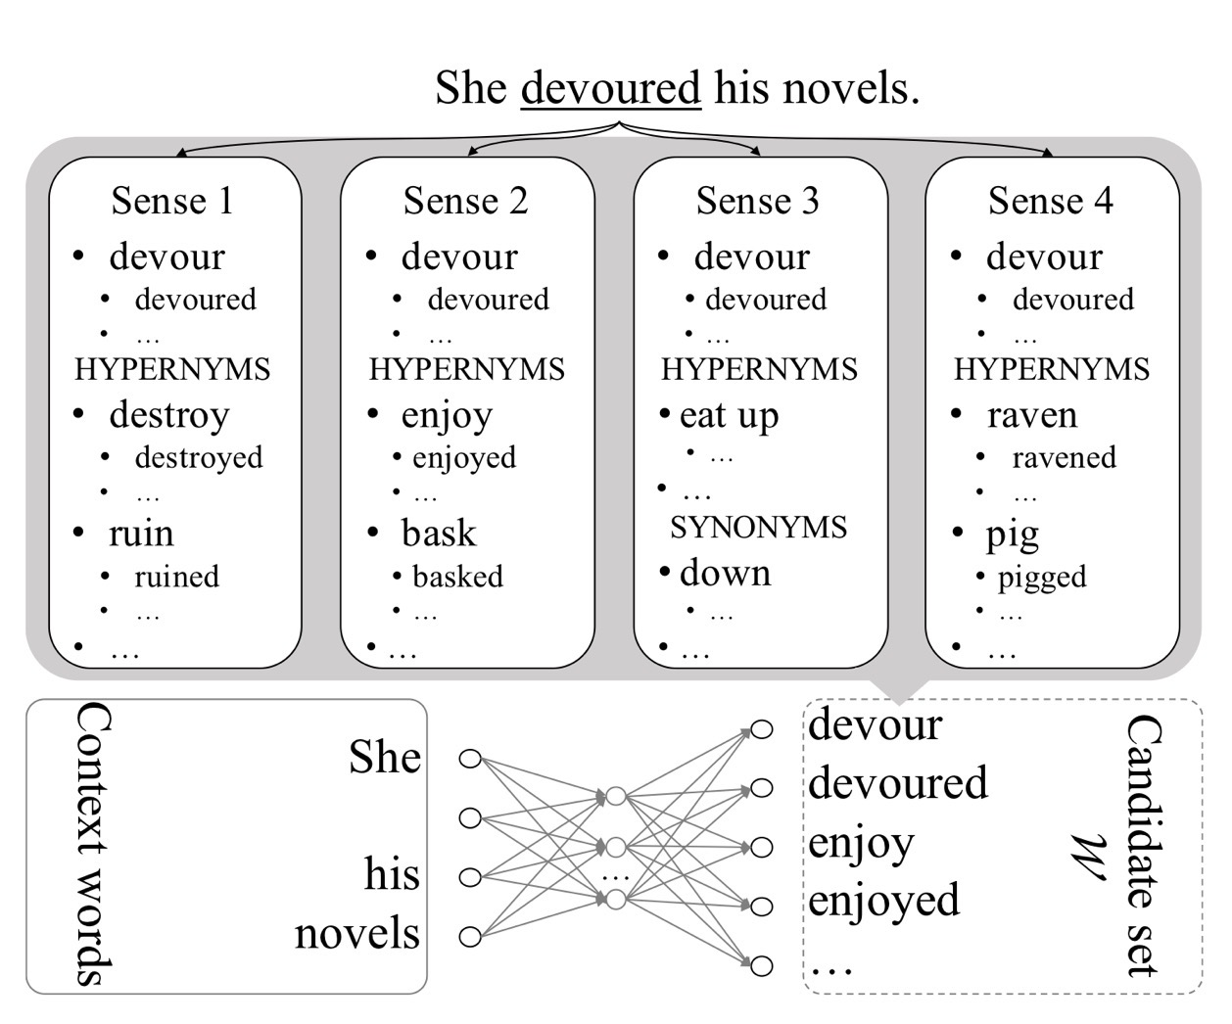
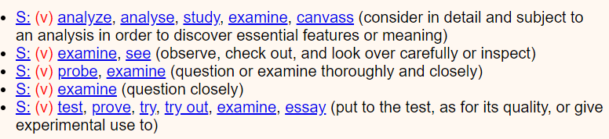
Method 2 : Example
Build a candidate set
Use CBOW model and Cosine similarity
Notes:
glosses

Slide 37
limited
No public dataset
No End-to-end model
Human evaluation
Design interface

Slide 38
5
Our current process
and timeline

Slide 39
Innovations on existed models
Apply modern linguistic theory
MIP and SPV implementation on Mao et al. (2019)
Interaction theory on Su et al.
We may find new existed linguistic theory and apply to model
Modify existed model
Fine-tuning
Try new method for contextual embedding: Bert, ElMo, etc.
Try new concatenation of models: RNN/BiLSTM/CRF etc.
Linguistic realization
Model
improvement
Add more elements
Consider sentence emotion
Augment abstractness analysis
Apply knowledge basis
Learn how to implement the WorkNet, HowNet etc. for interpretation
Find the attribute of a word.
Knowledge basis

Slide 40
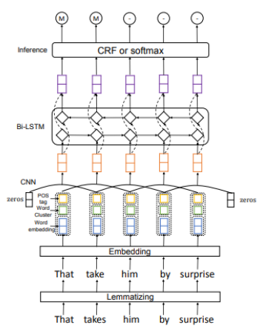
Modifying existed model
Take Wu et al. 2018 model as an example:
We may see it use Word2Vec-CNN-BiLSTM-CRF
Add more modules above or do fine-tuning
Replace it as RNN/DNN
Employ new ways of embedding:
ElMo, Bert, Glove..

Slide 41
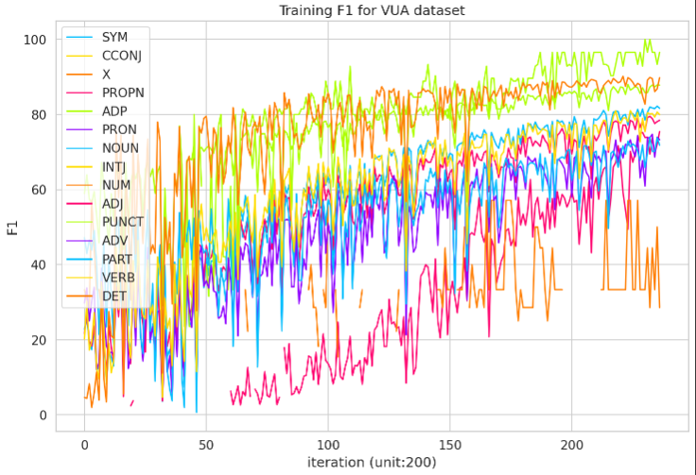
Different part of speech performs differently
Gao et al. 2018
Different part of speech (POS) of a word in metaphor may perform differently

Slide 42
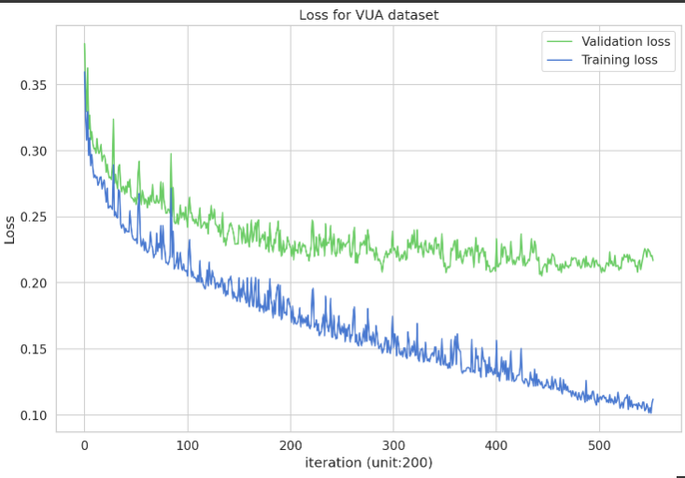
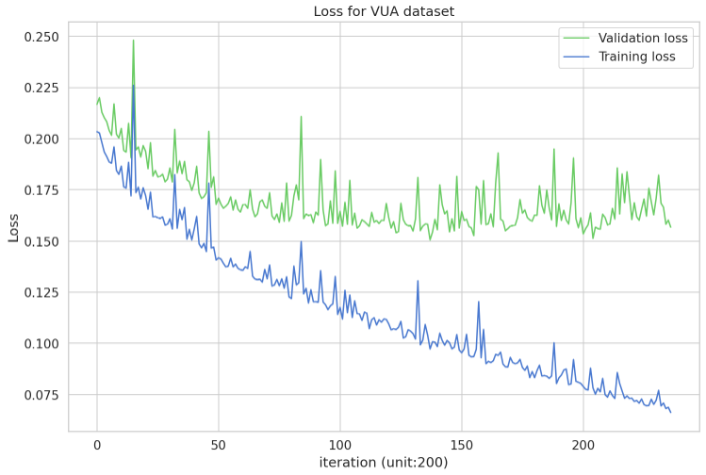
Apply modern linguistic theory
Prove that modern linguistic consideration may improve performance.
Gao et al. 2018
Mao et al. 2019
Mao et al. 2019 work is base on Gao et al. 2018
Mao makes improvement on the implementation of the linguistic theory, namely SPV and MIP

Slide 43
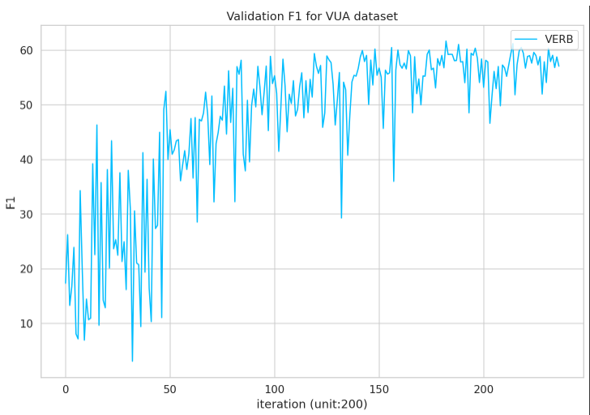
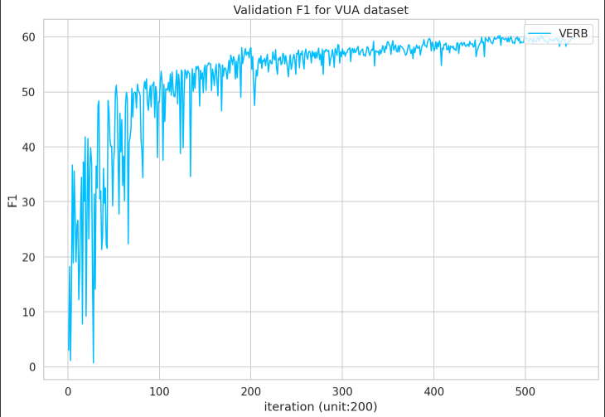
Apply modern linguistic theory
Prove that modern linguistic consideration may improve performance.
Gao et al. 2018
Mao et al. 2019
Mao et al. 2019 work is base on Gao et al. 2018
Mao makes improvement on the implementation of the linguistic theory, namely SPV and MIP

Slide 44
Consider sentence emotion
Emotional consideration for model improvement
It is a thorny problem to solve since I feel so despair about it.
Which word would you like to replace “thorny”?
Painful or Perplexity?
We use “painful”since we know the emotion of despair near to painful.

Slide 45
Apply knowledge basis
Interpretation model
Realization
External resource
Word attribute reasoning
Interaction of words
Wordnet etc.

Slide 46

Current process
Objectives | Finished or not
Find latest paper with models giving great performance
Collected the three latest train and test databases (VUA, MOH-X, TroFi)
Learning on Pytorch to practice building models like CNN/RNN/Bi-LSTM
Build Baseline implementation on Colab of (Mao et al. 2019) RNN-BiLSTM-HG/MHCA (Gao et al. 2018) Glove&Elmo-RNN-BiLSTM (Wu et al 2018) CNN-BiLSTM-CRF
Try implementation on pure Bert with softmax (seems not a good result, needs improvements)
Try implementation with concatenation of several input: Word2Vec/POS tagging/Glove/Elmo/Bert Based on (Mao et al. 2019) RNN-BiLSTM-HG/MHCA | Partial done

Slide 47
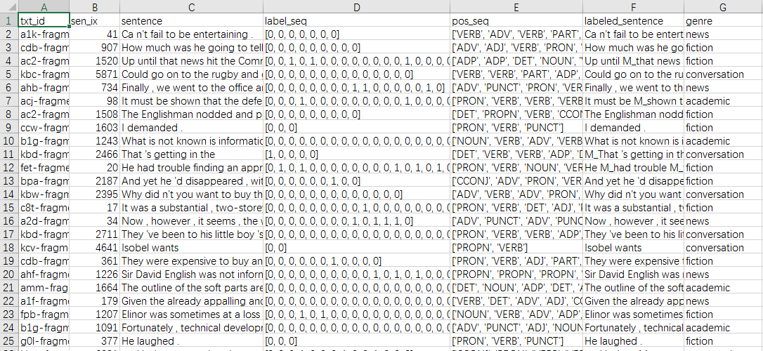
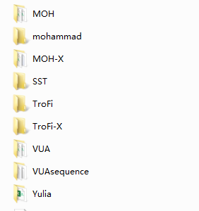
Database collection
Find all the database of metaphor detection
(Even including POS tagging.)

Slide 48
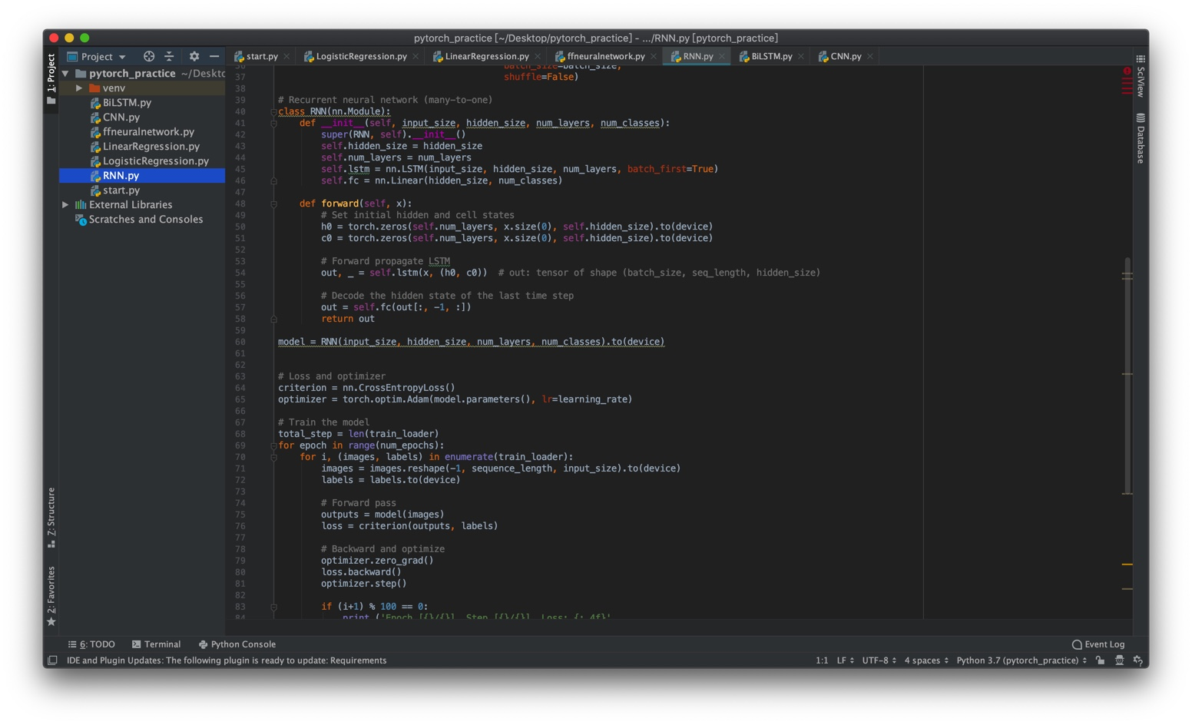
Learn how to use Pytorch
Try different models including CNN, RNN, BiLSTM, etc.

Slide 49
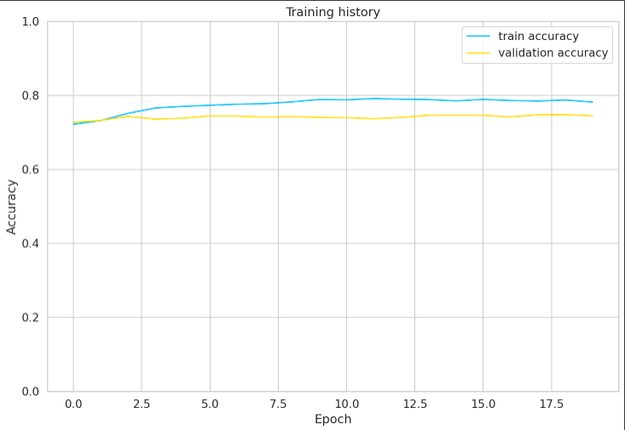
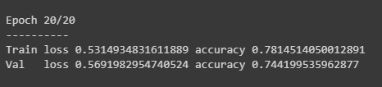
Try using pure BERT model
Build a bert model for metaphor detection
Seems not having a great result (｀・ω・´).
Anyway, improve it later.

Slide 50
Current process (cont’)
Objectives | Finished or not
Fine tuning on the three metaphor detection models. | Partial done
Add elements to our best modified model: Consider sentence emotion Augment abstractness analysis | Future work.
Build baseline of metaphor interpretation: (Mao et al. 2018) Word embedding and WordNet (Su et al, 2019) Meaning theory | Partial done
Build or find training dataset of metaphor interpretation | Future work.
Make improvement on the interpretation model: Consider emotion aspect and novel knowledge basis. | Future work.
Make integration for both tasks, directly apply to the state-of-the-art machine translation. | Future work.
Run multiple times for model and make further improvement. | Future work.

Slide 51
20 June 2020
Presentation today
1 July 2020
Bert implementation on existed RNN-BiLSTM detection model
20 July 2020
Timeline
Finishing metaphor detection model implementation by all considered ways
1 August 2020
Build baseline for metaphor interpretation
20 August 2020
Finishing metaphor detection model implementation by all considered ways
1 September 2020
Test Plan and Test Result

Slide 52
Thanks.
Notes:
2763f051-1fdc-4bde-b7de-a712ba8f68df

